Slide 1



SQL basic queries part 1
Sistem Basis Data
Rizka Wakhidatus Sholikah

Slide 2



Outline
Select
Where
www.its.ac.id
INSTITUT TEKNOLOGI SEPULUH NOPEMBER, Surabaya - Indonesia

Slide 3

Basic SELECT queries
SELECT query is used to retrieve data from tables
Syntax for basic SELECT query
FROM is the SQL clause that specifies the tables from which data is to be retrieve
Columnlist represent one or more attributes, separated by commas
www.its.ac.id
INSTITUT TEKNOLOGI SEPULUH NOPEMBER, Surabaya - Indonesia

Slide 4

Basic SELECT queries
When performing SELECT we can use wildcard character (*)
The wildcard means “all columns”
The query means to retrieve all columns from table PRODUCT
the query does not give limitation of the row being returned
www.its.ac.id
INSTITUT TEKNOLOGI SEPULUH NOPEMBER, Surabaya - Indonesia

Slide 5
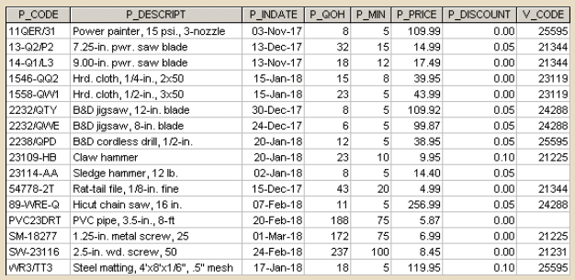
Basic SELECT queries
www.its.ac.id
INSTITUT TEKNOLOGI SEPULUH NOPEMBER, Surabaya - Indonesia

Slide 6

Basic SELECT queries
If the above query was executed the result will only get four columns
www.its.ac.id
INSTITUT TEKNOLOGI SEPULUH NOPEMBER, Surabaya - Indonesia

Slide 7
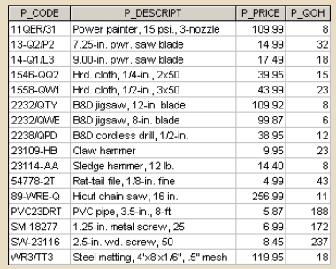
Basic SELECT queries
If we want to display the columns in different order, we can simply change the order of the columns in the columnlist
www.its.ac.id
INSTITUT TEKNOLOGI SEPULUH NOPEMBER, Surabaya - Indonesia

Slide 8
Column Aliases
When we retrieve the information from the table, the attribute become the column header
Can the header of the column be changed?
The header can be labeled in different name by using alias
Alias is referred to an alternative name for a column or table in a SQL statement
www.its.ac.id
INSTITUT TEKNOLOGI SEPULUH NOPEMBER, Surabaya - Indonesia

Slide 9

Column Aliases
Not all columns in a query must use an alias
AS is optional but recommended, if there is a space between the column name and the alias, the DBMS will interpret the alias correctly
Aliases that contain a space must be inside a delimiter (quotes)
www.its.ac.id
INSTITUT TEKNOLOGI SEPULUH NOPEMBER, Surabaya - Indonesia

Slide 10
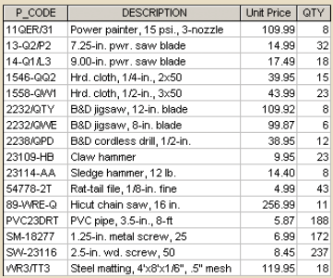
Column Aliases
www.its.ac.id
INSTITUT TEKNOLOGI SEPULUH NOPEMBER, Surabaya - Indonesia

Slide 11
Computed columns
A computed column also called a calculate column
A computed column represents a derived attribute
A derived attribute may or may not be store in the database
If the derived attribute is not stored in the db, then we have to calculate them
www.its.ac.id
INSTITUT TEKNOLOGI SEPULUH NOPEMBER, Surabaya - Indonesia

Slide 12
Computed columns
Example of computed column
To make the output more readable an alias is used for any computed fields
www.its.ac.id
INSTITUT TEKNOLOGI SEPULUH NOPEMBER, Surabaya - Indonesia

Slide 13
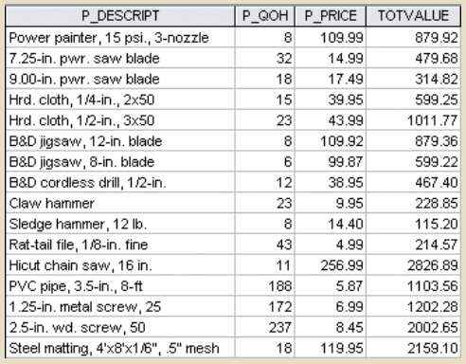
Computed columns
www.its.ac.id
INSTITUT TEKNOLOGI SEPULUH NOPEMBER, Surabaya - Indonesia

Slide 14
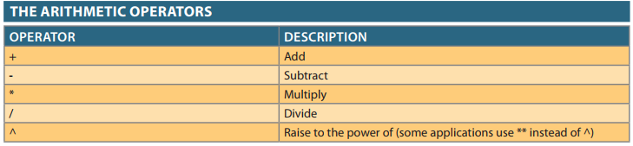
Arithmetic Operators
www.its.ac.id
INSTITUT TEKNOLOGI SEPULUH NOPEMBER, Surabaya - Indonesia

Slide 15
Arithmetic Operators
In SQL when performing arithmetic operation we have to considered about the mathematical rules of precedence
Rule of precedence establish the order in which computation are completed
The order of computational sequence:
Perform operations within parentheses
Perform power operations
Perform multiplications and divisions
Perform additions and subtractions
Example: (2+3)*5 → execute operation inside parenthesis then perform multiplication
www.its.ac.id
INSTITUT TEKNOLOGI SEPULUH NOPEMBER, Surabaya - Indonesia

Slide 16

Listing unique values
If we want to get only a unique value from certain column, we can use DISTINCT clause
DISTINC is a clause in SQL that produces only a list of values that are different from one another
www.its.ac.id
INSTITUT TEKNOLOGI SEPULUH NOPEMBER, Surabaya - Indonesia

Slide 17

FROM clause
FROM clause specify the table or tables from the data is to be retrieved
The query retrieves information from table PRODUCT
In practice, most SELECT queries will need to retrieve data from multiple tables
www.its.ac.id
INSTITUT TEKNOLOGI SEPULUH NOPEMBER, Surabaya - Indonesia

Slide 18

WHERE clause
WHERE clause is used to give restriction to the search criteria
The conditionlist in the WHERE clause of the SELECT statement is represented by one or more conditional expressions, separated by logical operators
If NO ROW match the criteria in the WHERE clause, we will get the blank screen
www.its.ac.id
INSTITUT TEKNOLOGI SEPULUH NOPEMBER, Surabaya - Indonesia

Slide 19


WHERE clause
Example:
www.its.ac.id
INSTITUT TEKNOLOGI SEPULUH NOPEMBER, Surabaya - Indonesia

Slide 20
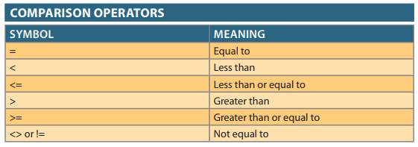
WHERE clause
Numerous comparison operator can be placed on the selected table contents
www.its.ac.id
INSTITUT TEKNOLOGI SEPULUH NOPEMBER, Surabaya - Indonesia

Slide 21

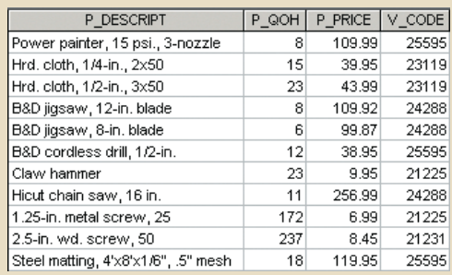
WHERE clause
Example:
www.its.ac.id
INSTITUT TEKNOLOGI SEPULUH NOPEMBER, Surabaya - Indonesia

Slide 22

Logical operators: AND, OR, and NOT
In the real world, a search of data normally involves multiple condition
SQL allows to include multiple conditions in a query through the use of logical operators
Example:
www.its.ac.id
INSTITUT TEKNOLOGI SEPULUH NOPEMBER, Surabaya - Indonesia

Slide 23
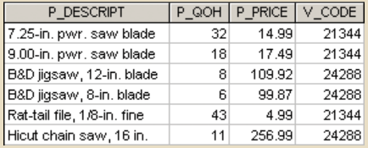
Logical operators: AND, OR, and NOT
www.its.ac.id
INSTITUT TEKNOLOGI SEPULUH NOPEMBER, Surabaya - Indonesia

Slide 24
Logical operators: AND, OR, and NOT
OR
The SQL logic operator used to link multiple conditional expression in WHERE or HAVING clause
It requires only one of the conditional expressions to be true
AND
The SQL logic operator used to link multiple conditional expression in WHERE or HAVING clause
It requires ALL of the conditional expressions to be true
NOT
The SQL logical operator that used to negate the result of a conditional expression
NOT is used to find the rows that do not match a certain condition
www.its.ac.id
INSTITUT TEKNOLOGI SEPULUH NOPEMBER, Surabaya - Indonesia

Slide 25

Logical operators: AND, OR, and NOT
Example
www.its.ac.id
INSTITUT TEKNOLOGI SEPULUH NOPEMBER, Surabaya - Indonesia

Slide 26

Logical operators: AND, OR, and NOT
The condition in WHERE clause can also be grouped together using parenthesis
The condition inside the parentheses are always executed first
Example
www.its.ac.id
INSTITUT TEKNOLOGI SEPULUH NOPEMBER, Surabaya - Indonesia

Slide 27
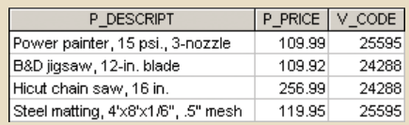
Logical operators: AND, OR, and NOT
www.its.ac.id
INSTITUT TEKNOLOGI SEPULUH NOPEMBER, Surabaya - Indonesia

Slide 28
Thank you

